Slide 1
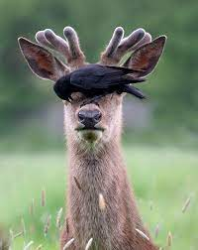


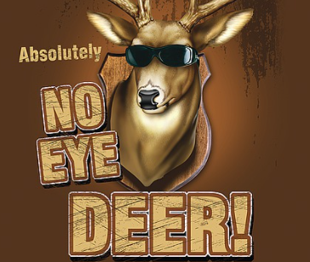
Classification of Handwritten Chinese Number Characters
Team: No Eye Deer
Beibei Du, Jeffrey Feng, Luning Yang, Jiayi Zhao, Tian Zhong, Huaning Liu

Slide 2
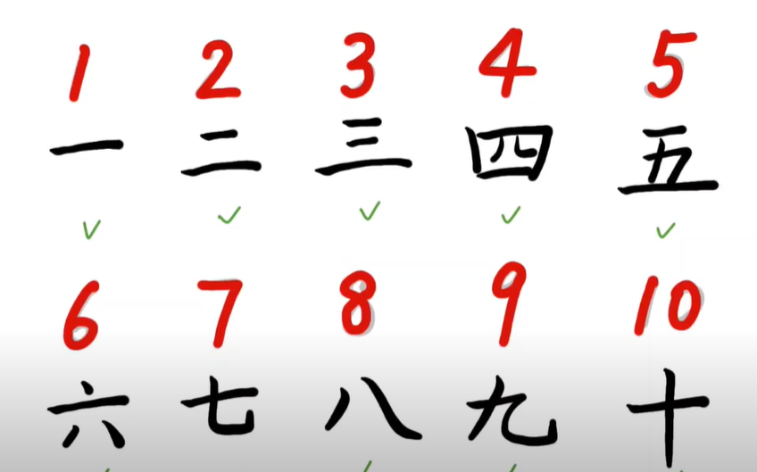
Motivation
With pattern recognition algorithms, we can easily combine computer vision to relieve information from bills, printed documents, and writings.
For this prediction task, we want to be able to compare different machine learning algorithm on their performance to classify the handwritten number characters in Chinese.
Notes:
With pattern recognition algorithms, we can easily combine computer vision to relieve information from bills, printed documents, and writings. So it is very useful and it make informational retrieval very easy. With that motivation, we want to be able to compare different ML algorithm (including supervised, and deep learning) on their performance to classify the handwritten number characters in Chinese.

Slide 3
Literature Review
Source 1: Chinese Character Recognition
This paper explores general methods of character recognition and suggests a formula that fits more closely with Chinese Handwritings.
Why Interesting: Rather than following traditional pixel-splitting techniques to address image processing problems, it develops a new formula as approach that might be more general for Chinese characters
Why select this (relate to our study): Although we’re not looking in-depth about the formula things, we share the same topics and thus hope to find inspirations from their approaches.
How is this relating to other papers: The proposed algorithms are all formula-based.

Slide 4
Literature Review
Source 2: Dimension Reduction for Classification Cases
This paper deals with several dimension reduction algorithms to help accelerate and optimize the dimension reduction and feature selection process, including filter algorithms, hybrid algorithm, etc. And attempts to formulate a integrated intelligent feature selection system.
Why Interesting: It attempts to actually automize the dimension reduction process
Why select this (relate to our study): This might be useful if we have too much dimensions when building the model, which might lead to long running time.
How is this relating to other papers: Compared with other papers that attempts to build classification models for labels or characters, this paper focuses on the platform of automating dimension reduction.

Slide 5
Literature Review
Source 3: NLP & Classification
This paper first reviews some recent findings about supported entity types in NLP, then proposes several algorithms to tackle the Named Entity Recognition and Classification (NERC) tasks.
Why Interesting: I really like the EDA part, looking at the character statistics from many perspectives
Why select this (relate to our study): Although the NERC topic in NLP is too abstract and in-depth compared with our project, I think they proposed good approach of a classification process, including feature engineering and, modeling.
How is this relating to other papers: Compared with other papers, this, rather than developed a formula or algorithm, parallelly proposed and lists the evaluation of several models, and presents the comparing result, which is relatively a traditional ML process.

Slide 6
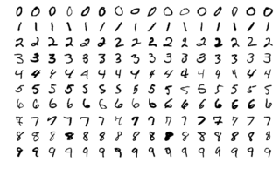
Data
MNIST is a large database of handwritten digits that is commonly used for training various image processing systems. We found the Chinese MNIST dataset on Kaggle, which includes 72-MB 15000 compressed images. Each image shows one character from a set of 15 characters.
The data can be found here: https://www.kaggle.com/gpreda/chinese-mnist?select=data
Notes:
Chinese language does not have a alphabet, so there are thousands of common characters. For the simplicity of this study, we will only focus on the number, as this task is useful enough.

Slide 7
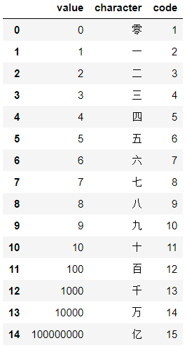
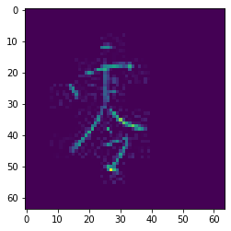
Cleaning/EDA
The distinct labels and their representing Chinese characters can be found in the table below on the left, the 15000 instances of characters, along with the array representation of the image is shown on the right.
Pixel: 64 * 64
Notes:
The 15 distinct labels and their representing Chinese characters in the image on the right. For each image, we flatten the 2d image gray scale value, so original image size is 64 pixel * 64 pixel, 4097

Slide 8
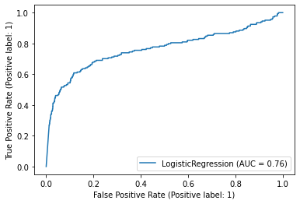
Experiment: Binary Classification
Sklearn: logistic regression
Task: identify all the images with label “1”
Split: 80% train, 20% test
Performance with penalty:
train accuracy 100%
test accuracy 90%
This is not the accuracy for the multi-class prediction!
Notes:
How to make binary -> multi nominal: we can train 15 models on the data, each tries to predict the character for one image. So we will have 15 predictions, than we use some sort of voting methods to determine which label is the winner, but LOGREG may be very minimal, so we move on with more advanced binary algorithm for more experiement

Slide 9
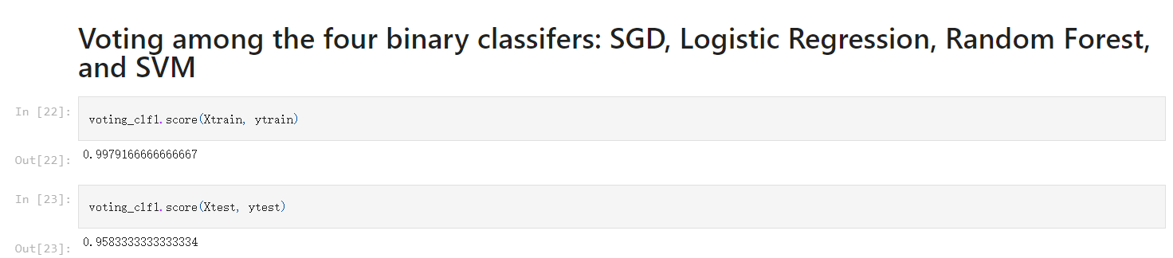
Bagging Binary Classifiers
Notes:
To continue with the binary classification, we wonder if we can do a better binary classifiers by using bagging and voting method. The Bagging Method used there is to sample the training data multiple times for the predictors. Specifically, different samples are being extracted with replacement (bootstrapping) to be trained in certain algorithms. We try to use Bagging on Four binary classifiers: SGD, Logistic Regression, Random Forest, and SVM. They ended up with a training score of 0.9325 and a testing score of 0.93667. And this is same accuracy as saying no every time, which is 14/15.Since we have 15 characters, we need to get its 15th power, which is 0.3748.(37.48%).
The Voting method is to combine the four potential binary classifiers and output a better prediction while combining all of them. By using this ensemble method, it will achieve a higher accuracy than the best single classifier in the all four possible classifiers. And this is the well-known “wisdom of the crowd”.

Slide 10
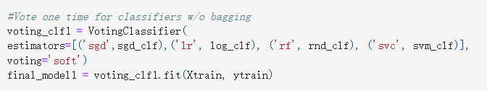
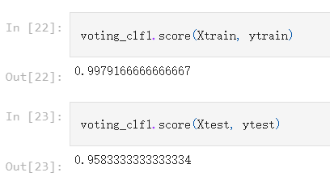
Voting Binary Classifiers

Slide 11
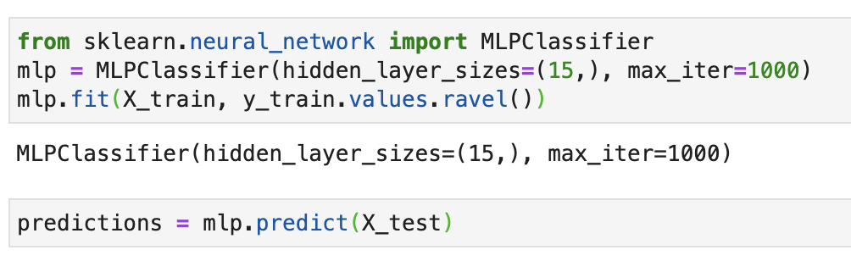
Artificial Neural Network(Multilayer Perceptron) with sklearn
Multi-layer perceptrons, or artificial neural networks, are a combination of multiple neurons connected in the form a network. Unlike logistic regression, an artificial neural network has an input layer, one or more hidden layers, and an output layer.
We use Python's Scikit-Learn library to create our neural network that performs this classification task. Given a set of features X and a target y, it can learn a nonlinear function approximation for classification or regression.
Notes:
with sklearn, you can create neural network with these three lines of code, which all handles much of the leg work for you. We use MLPClassifier class from the sklearn.neural_network library that specifies the number of iterations, combination of one cycle of feed-forward and back propagation phase, that you want your neural network to execute.

Slide 12
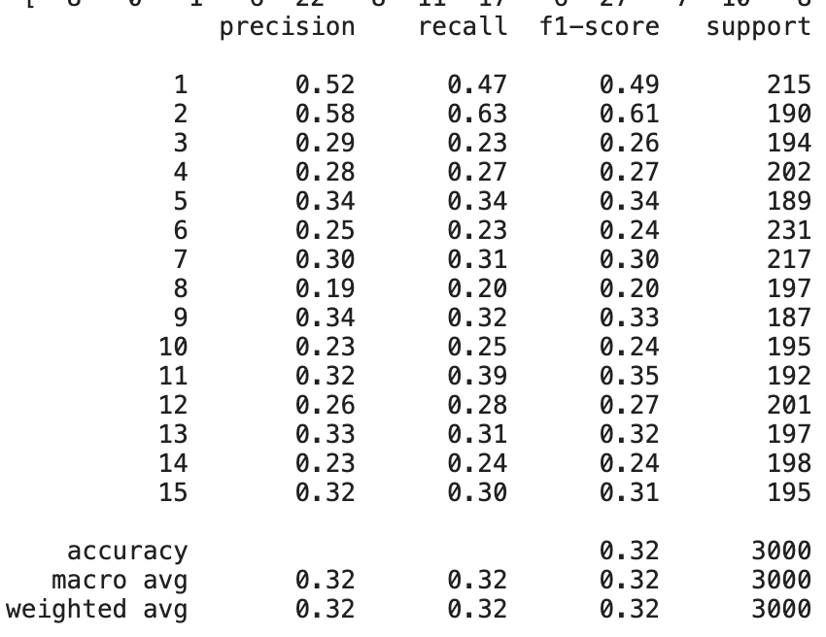
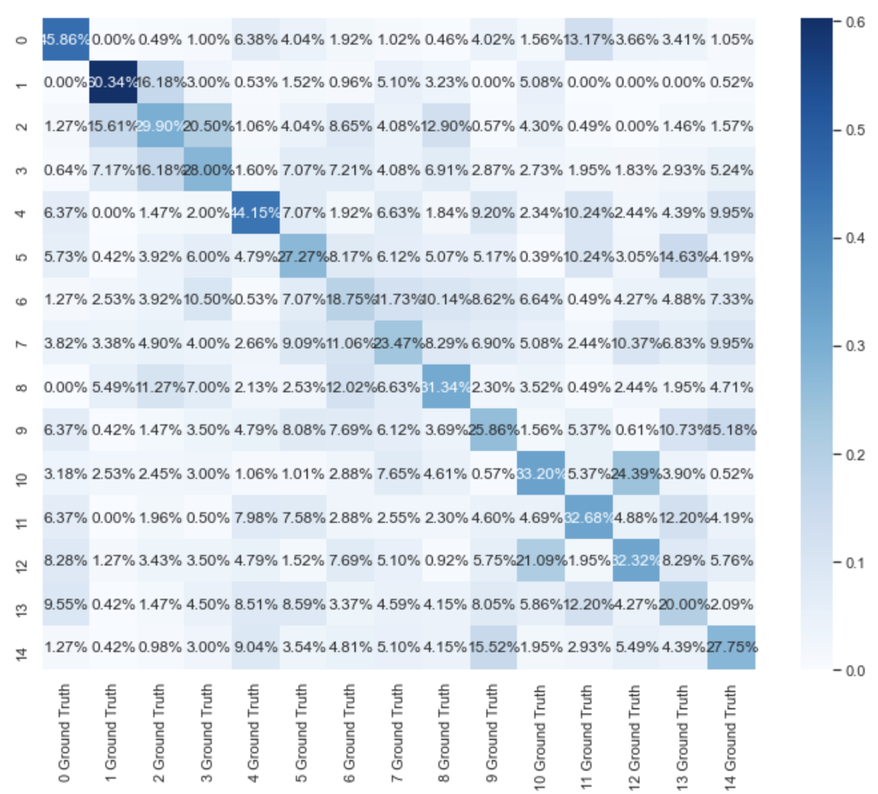
MLP with sklearn
You can see the confusion matrix that every row is ground truth and every column is prediction
Also, the f1 score of 0.32 is quit bad, given the fact that we had 3000 instances to train.

Slide 13
Baseline model: Logistic regression
Sklearn logistic regression has a multinomial classification predictor.
Train accuracy: 67%, test accuracy 36.2%
Take away: try grid search, different algorithms

Slide 14
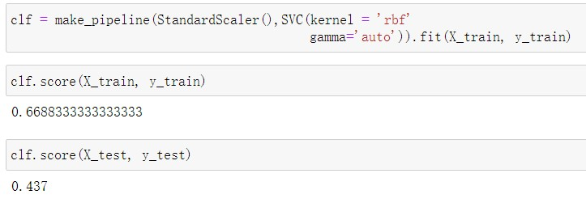
SVM
Support vector machines (SVMs) are a set of supervised learning methods used for classification, regression and outliers detection.
Radial Basis Function (RBF) Kernel

Slide 15
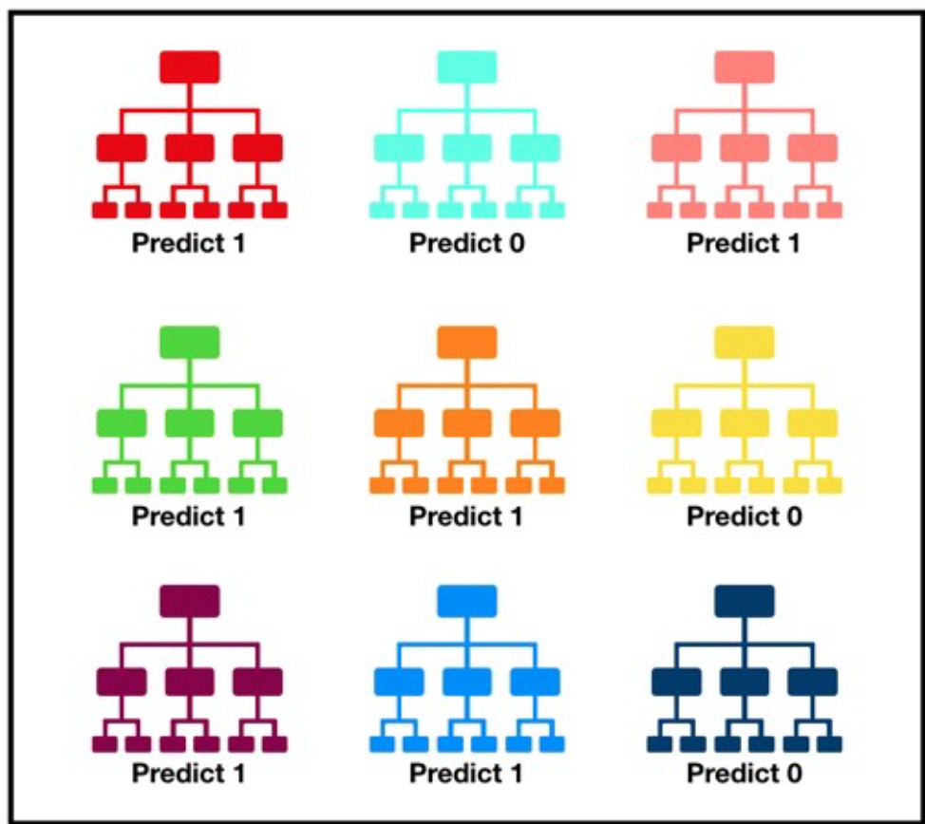
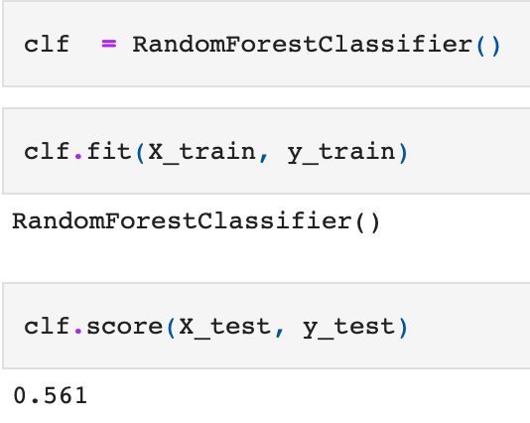
Random Forest
Random forest classifier implements classification based on several decision trees (`n_estimators`). Each decision tree gives a prediction outcome, and the final result of the random forest depends on the outcome that occurs the most times among the decision trees.
Image from: https://towardsdatascience.com/understanding-random-forest-58381e0602d2
Simply running the algorithm, we get an accuracy of 0.561
Notes:
Looking at an image, each tree

Slide 16
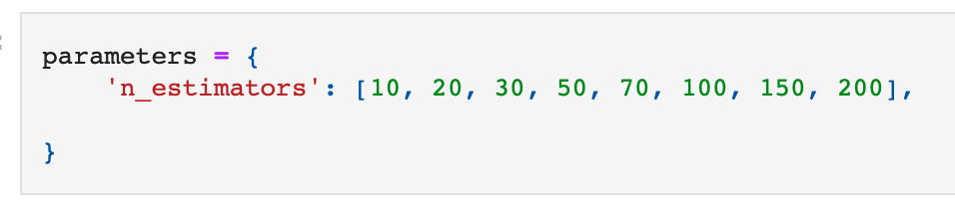
Grid Search
How can we decide how many decision trees we should use for a given random forest model? Fit many RF models with different `n_estimator` and compare their performance?
For example, if there are 8 possible choices for the `n_estimators`, how do you compare them?

Slide 17
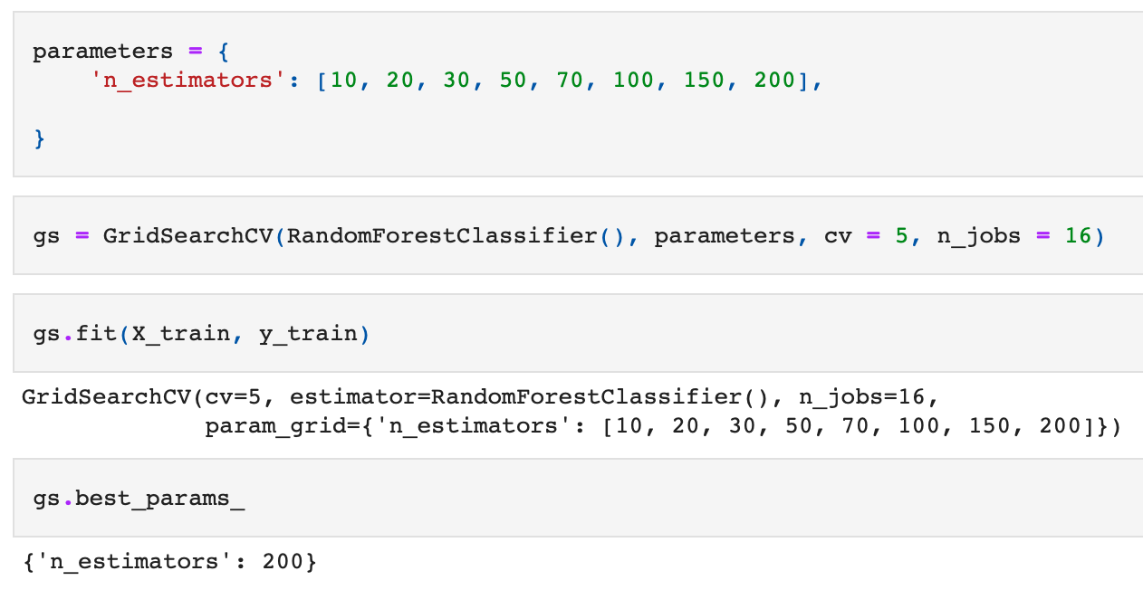
Grid Search
One way is to use the method GridSearchCV
create a model per combination of the parameters and assess the performance based on K-fold validation
The model that has the best performance is when `n_estmators` = 200

Slide 18
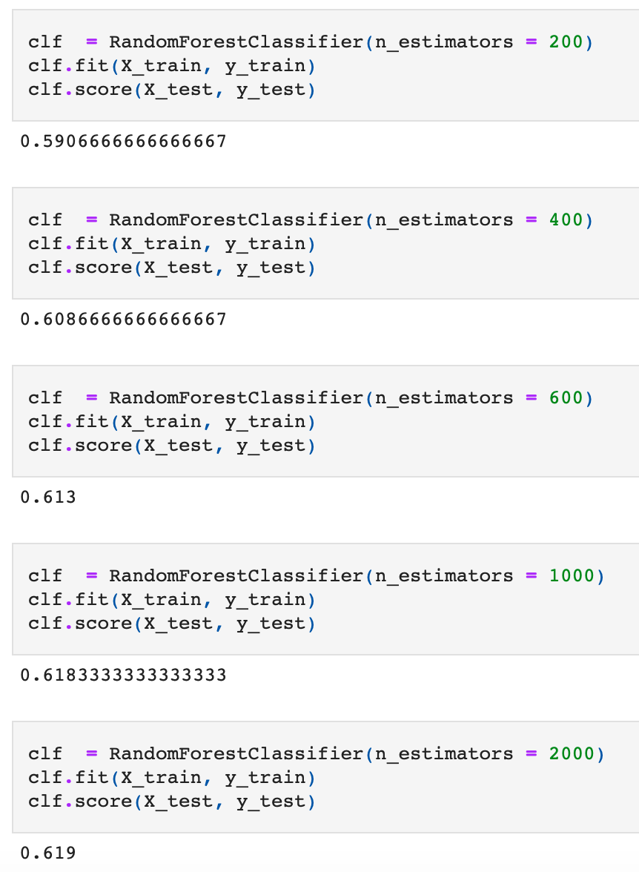
Inference on the result
It is interesting to note that the best `n_estimators` is the largest one among our choices. Does that mean the test accuracy will increase as `n_estimators` increases?
This is somehow true when we increase the `n_estimators` from 200, 400, 600, till 1000. However, the test accuracy doesn’t increase a lot when we double our `n_estimators` from 1000 to 2000.
This is true probably because our model involves 4095 pixel values as features. A high number of features demands a high model complexity.

Slide 19
ADABoost Classifier with scikit-learn
A basic boosting algorithm that repetitively fits the classifier based on the mistakenly predicted cases last time
This, by my opinion, is quite a baseline model in gradient boosting algorithm, as the original correct label might be predicted wrong when optimizing the original wrong ones.
After tuning by GridSearch, we choose the n_estimators to be 300, and learning rate to be 1, with a base estimator of Random Forest.
The train score is reported to be 1, with a test accuracy of 57.3%.
This is even lower than previous tuned random forest model, which indicates a possible overfitting case

Slide 20
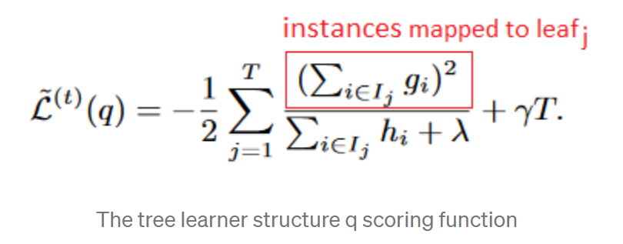
XGBoost Classifier
This is a high efficient gradient boosting algorithm to boost tree algorithms
Formula behind:
The train score is reported to be 0.99775, the test accuracy is reported to be 0.627
Take-away: This algorithm performs better, as it no longer only focuses on the “error” ones in the previous training.

Slide 21
LightGBM Classifier
LGBM is a gradient boosting framework based on tree algorithms developed by Microsoft. Compared with previous two Gradient Boosting Algorithms, it takes faster running time and generally strong performance, but being more sensitive to overfitting.
To avoid overfitting, we try to restrict the max_depth and learning rate parameter to be 12 and 0.01 to limit the growth of trees. Then, grid search another important parameter -- num_leaves, and set it to be 41.
The train accuracy is reported to be 100%, the test accuracy is reported to be 71.8%.
Still being in the risk of overfitting, but the performance has been good enough for LGBM.
Balanced Error Rate: 29.4%

Slide 22
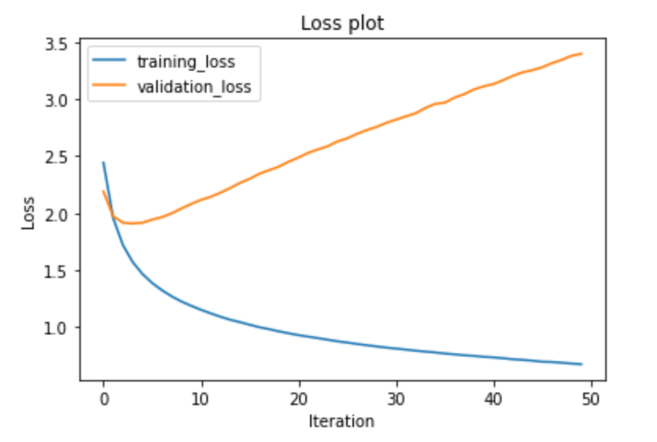
Multi-Layer Perceptron Classifier with PyTorch
This is a extension of previous MLP model, in which I rewrite the algorithm with PyTorch and detect if the accuracy changes
After several attempts, we settle the number of epochs to be 50, learning rate to be 0.01 and batch size to be 64.
We take the criterion as cross entropy loss and optimizer as Adam.
Train Accuracy: 79.52%, Test Accuracy: 35.2%
Take-away: Issue of Overfitting
Note: Validation is actually test set here
Note: SGD causes a disaster

Slide 23
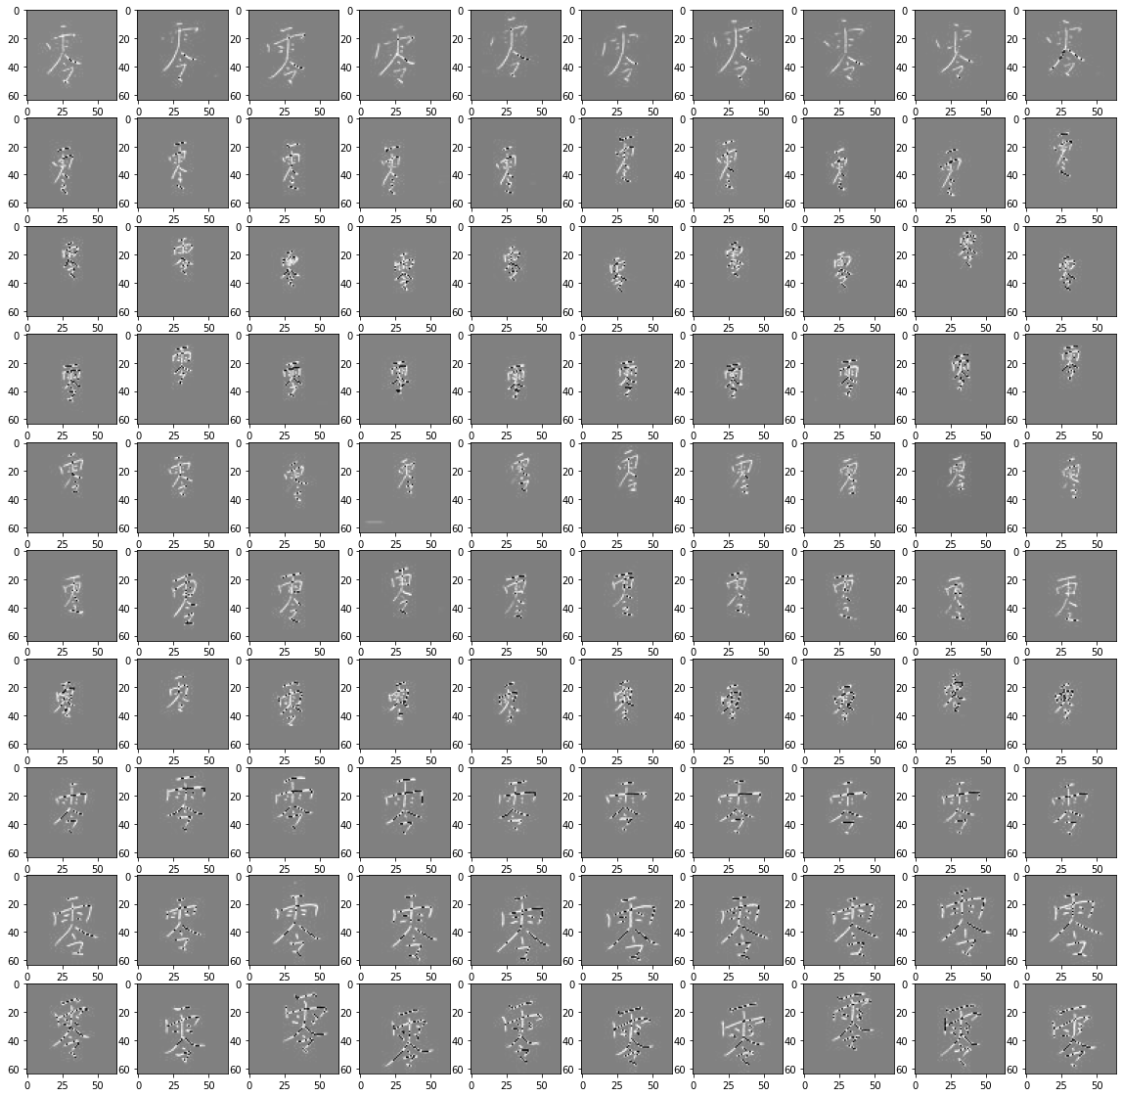
Problem with conventional supervised ML algorithm
Figure shown all the “zero” image
Different position
Different font size
Different handwriting style..

Slide 24
CNN with PyTorch
Finally, we used Pytorch Convoluted Neural Network model and obtained a test accuracy of 89%.
CNN((dropout): Dropout(p=0.4, inplace=False)
(pool): MaxPool2d(kernel_size=2, stride=2, padding=0, dilation=1, ceil_mode=False)
(conv1): Conv2d(1, 5, kernel_size=(5, 5), stride=(1, 1))
(conv2): Conv2d(5, 30, kernel_size=(5, 5), stride=(1, 1))
(fc1): Linear(in_features=5070, out_features=300, bias=True)
(fc2): Linear(in_features=300, out_features=50, bias=True)
(fc3): Linear(in_features=50, out_features=20, bias=True)
(activation): LogSoftmax(dim=1))

Slide 25
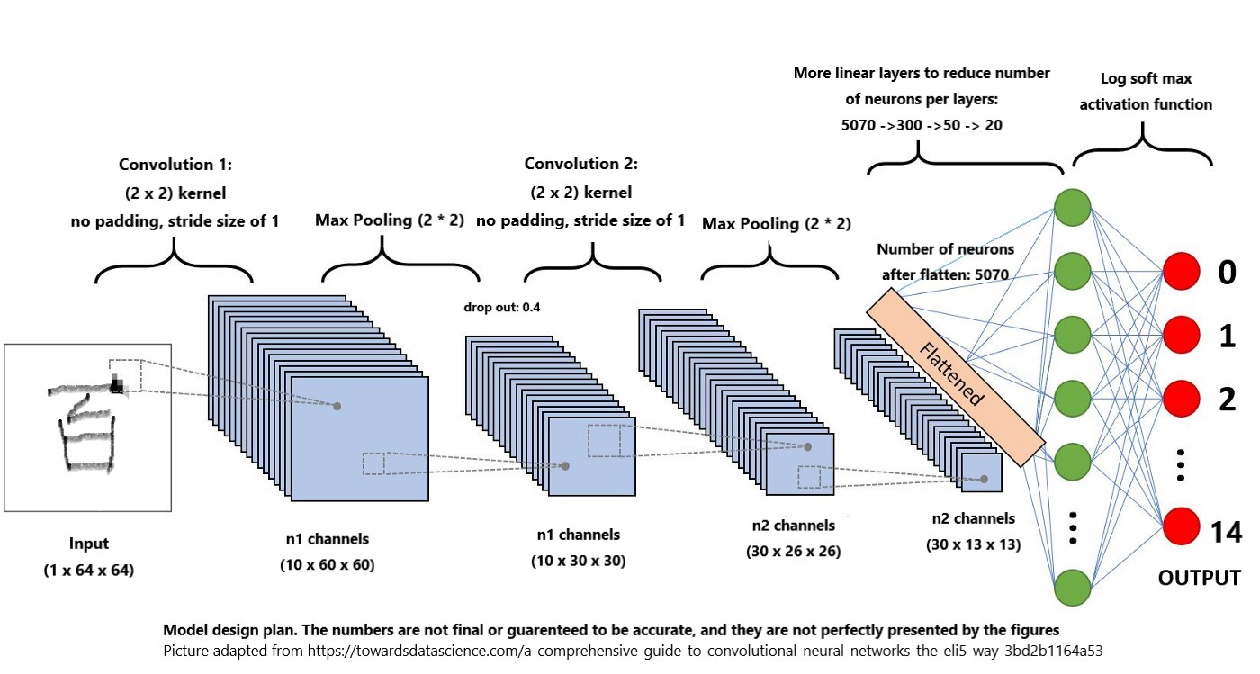

Slide 26
Result Present & Take-away
Algorithm(Model) | Test Accuracy
Binary: LogReg | ~20%
Binary: Bagging & Voting | ~37.48%, 52.81%
MLP | ~32%
Baseline (LogReg) | 36.2%
SVM | 43.7%
Random Forest | 61.8%
ADABoost | 57.3%
XGBoost | 62.7%
LightGBM | 71.8%
CNN | 89.0%
Traditional models are outperformed by boosting, bagging methods
Confirm that CNN achieve the best performance for image classification
Future improvement:
Update CNN model with better structure and parameters (change padding, pooling… etc)
Use a smaller sample data so it doesn’t take too long to train
Try recurrent neural network, because of the natural writing order.

Slide 27
Links
Written Report: https://docs.google.com/document/d/1ouunkNe6c57gTHiGRekZm0cppU8DFarIOkeBktWPe3k/edit?usp=sharing
Github Repo:
https://github.com/COGS118B-character-classification/Chinese-MNIST

